Slide 1

Interactive Paint
Team Member(s): Alain Galvan, Justin Alvarez, Jacob Leschen, Jose Morgan Product Owner(s): Francisco Ortega
Instructor: Masoud Sadjadi School of Computing and Information Sciences Florida International University
Final Presentation
Fall 2016
Notes:
7 seconds.
Greet your audience, thank them for attending your presentation, introduce yourself, introduce your project, introduce your team members, and quickly indicate what each of you did in a high-level manner, and put more emphasis on your part/contribution.

Slide 2
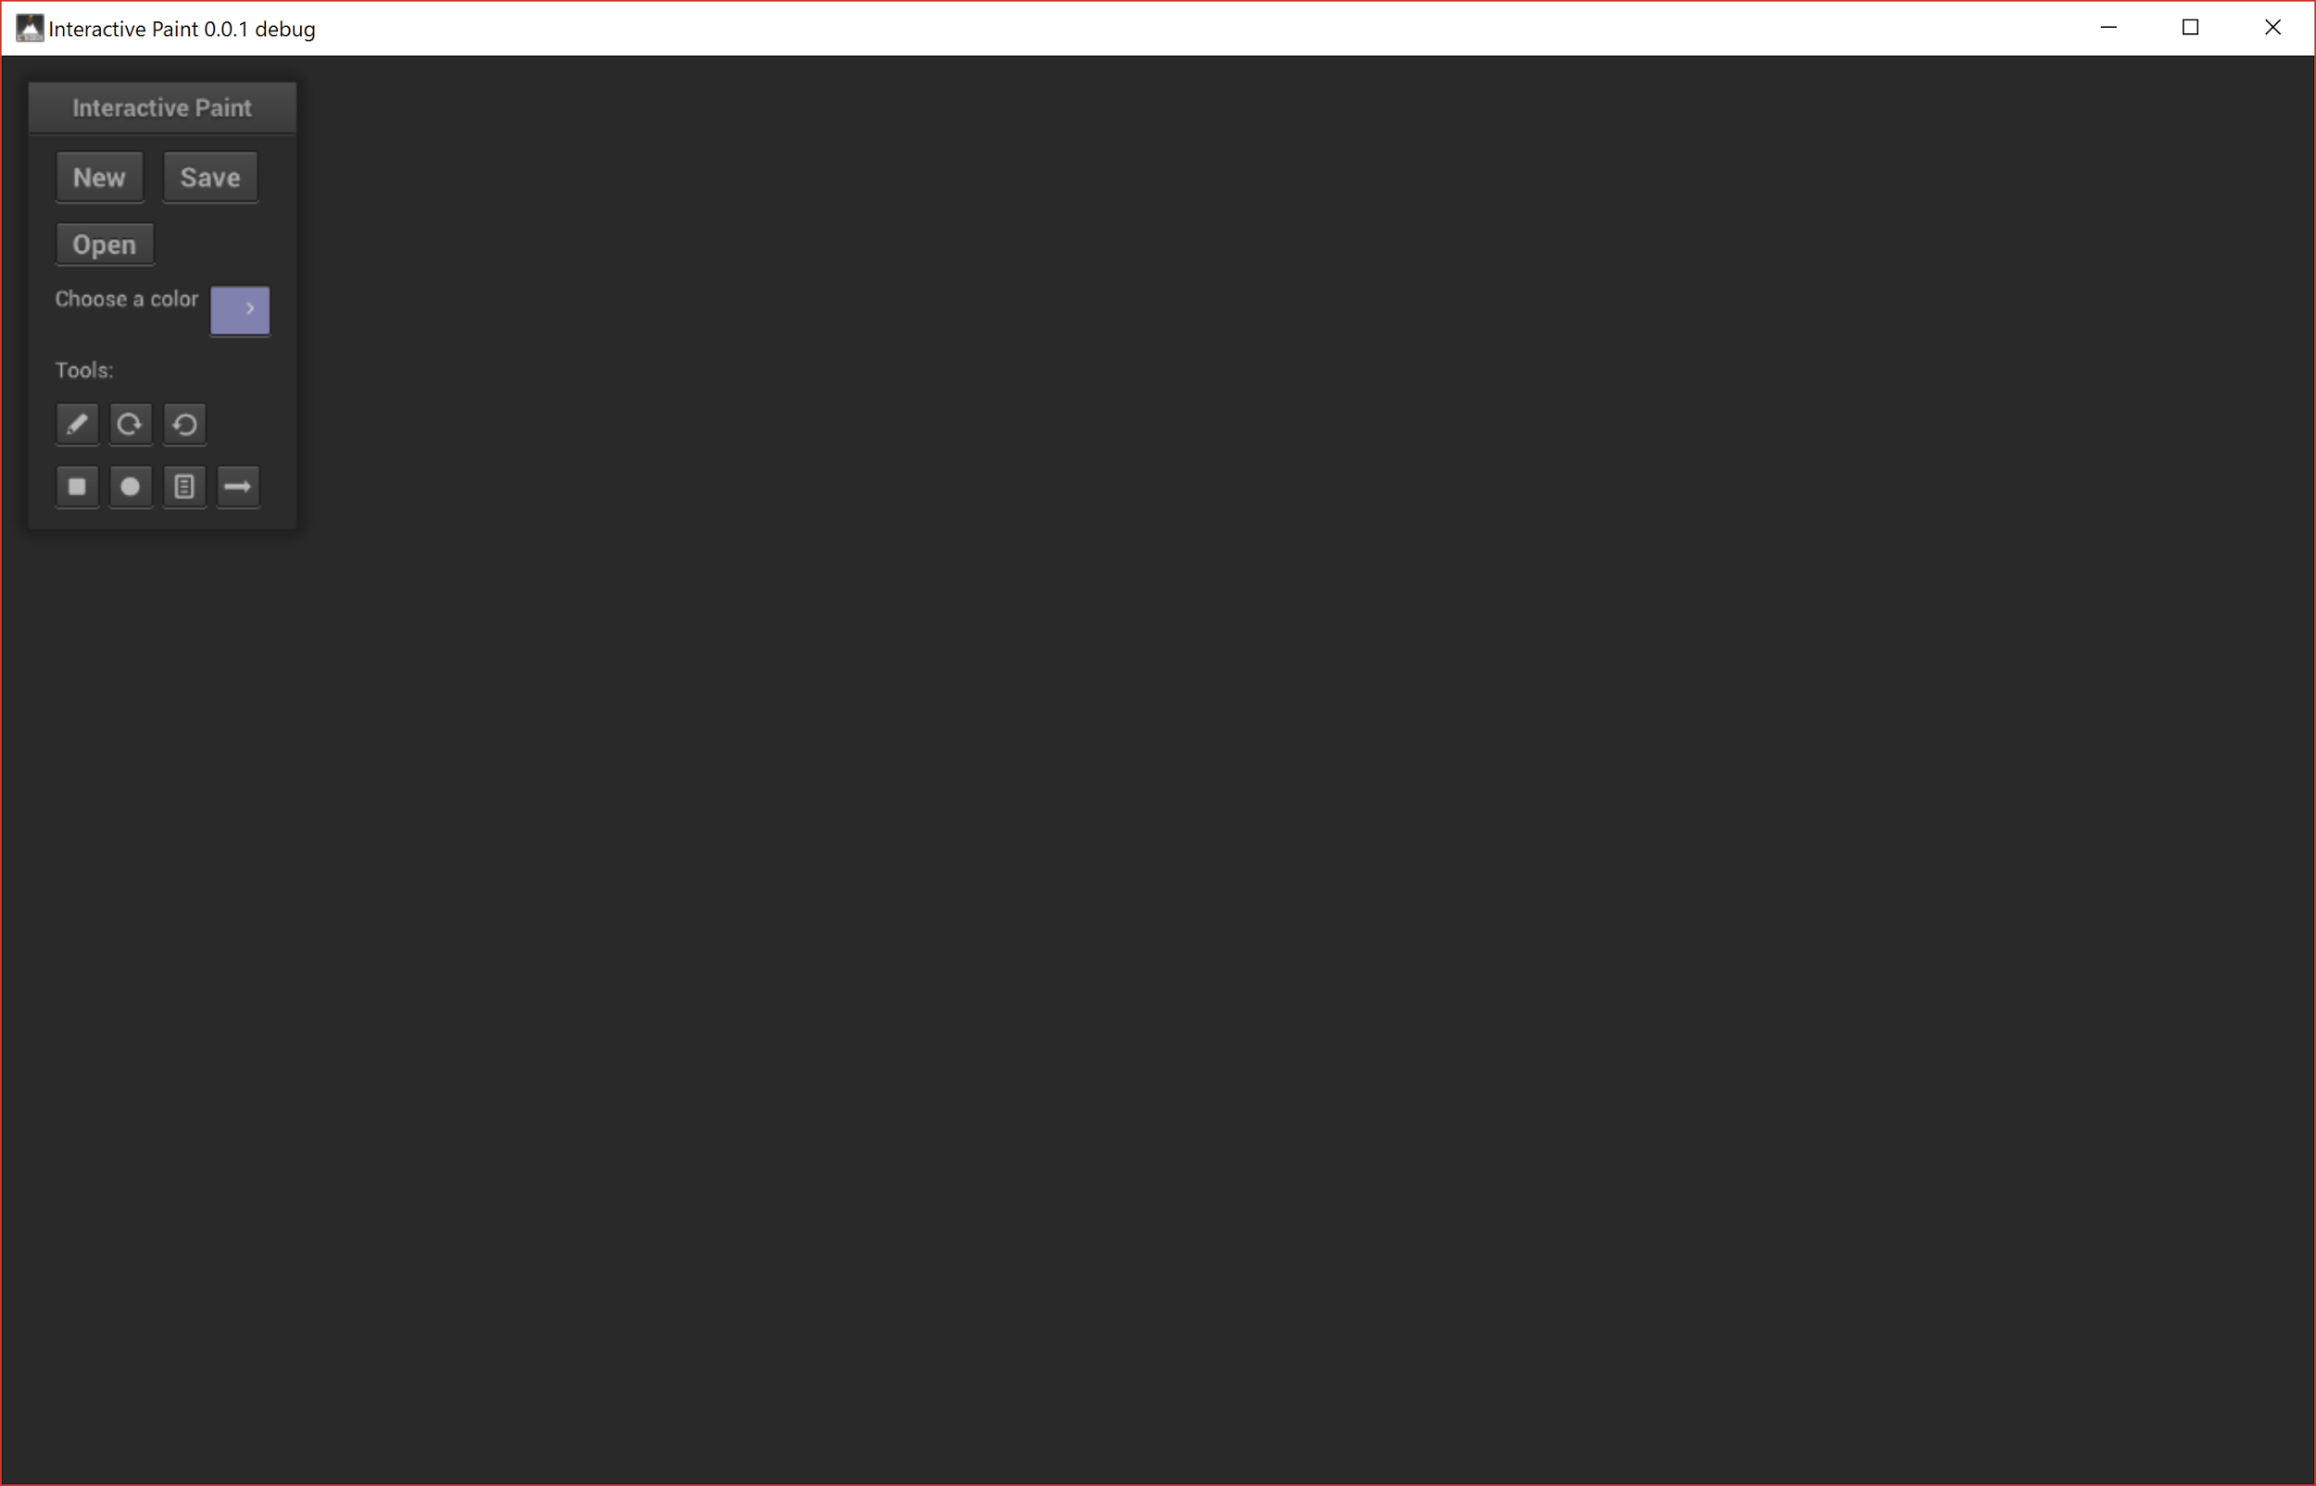
Interactive Paint definition
The Interactive Paint application serves as a showcase of what can be done with different input devices such as the Leap Motion, Intel RealSense, Kinect and Multitouch display. It is also a framework for integrating these devices.
Notes:
10 seconds.
Introduce the problem that the whole project (in all versions) tackles with GIF or screenshot.

Slide 3
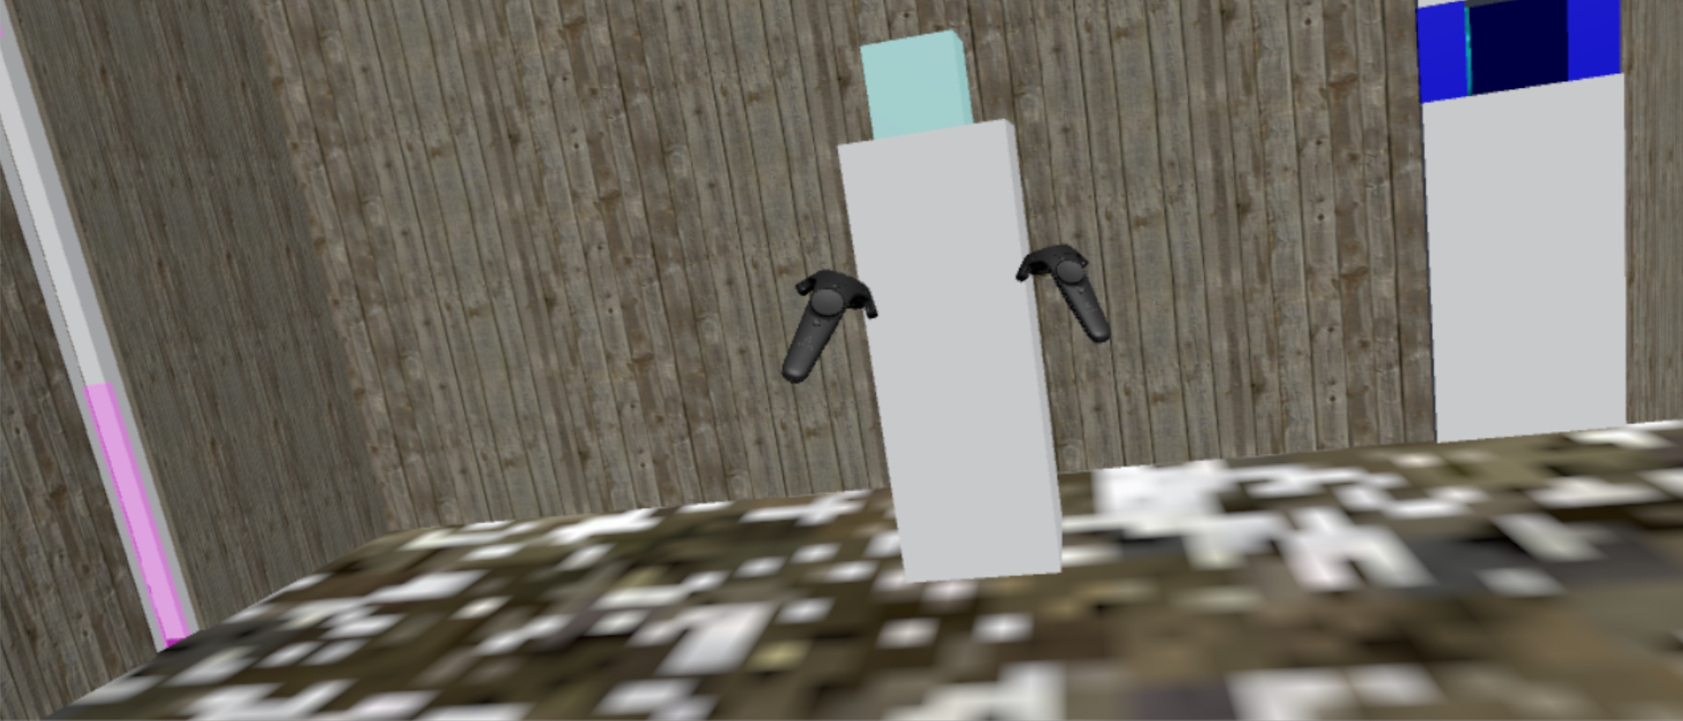
Project definition
Notes:
20 seconds.
Introduce the problem that the your project (in new version) tackles with GIF or screenshot.

Slide 4
Requirements: Use Cases
Notes:
5 seconds
Show the Use Case Diagram for the whole project. Highlight your use cases.

Slide 5
System Design: Architecture
Actor Model - Components are independent actors in an application, and all aspects of the interactive paint project have taken advantage of this pattern (Unity).
Object Composition - In an attempt to avoid complex classical hierarchies while programming in a more functional ML manner, we’ve opted to use Object Composition as a mechanism for reuse.
Notes:
20 seconds
System design: Highlight the parts that you contributed to them.
1. System decomposition; identify the architecture patterns used
2. System deployment – h/w and s/w requirements

Slide 6
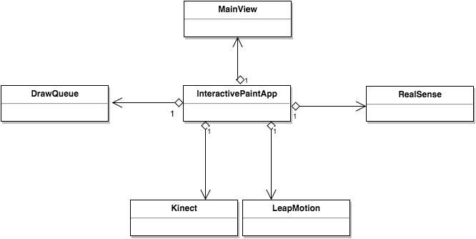
Minimal Class Diagram
Notes:
10 seconds.Minimal class diagram. Highlight the classes that you created/modified
Identify the design patterns used (one or more slides).

Slide 7
User Stories
1.User Story #201 - Make input devices work with application
2.User Story #230 - HMD Game Framework
3.User Story #202 - Add tools to new Cinder integrated project
Notes:
5 seconds.
List the user stories that you worked on them.(put in order of importance). Stay focused on the parts that you have been working.

Slide 8
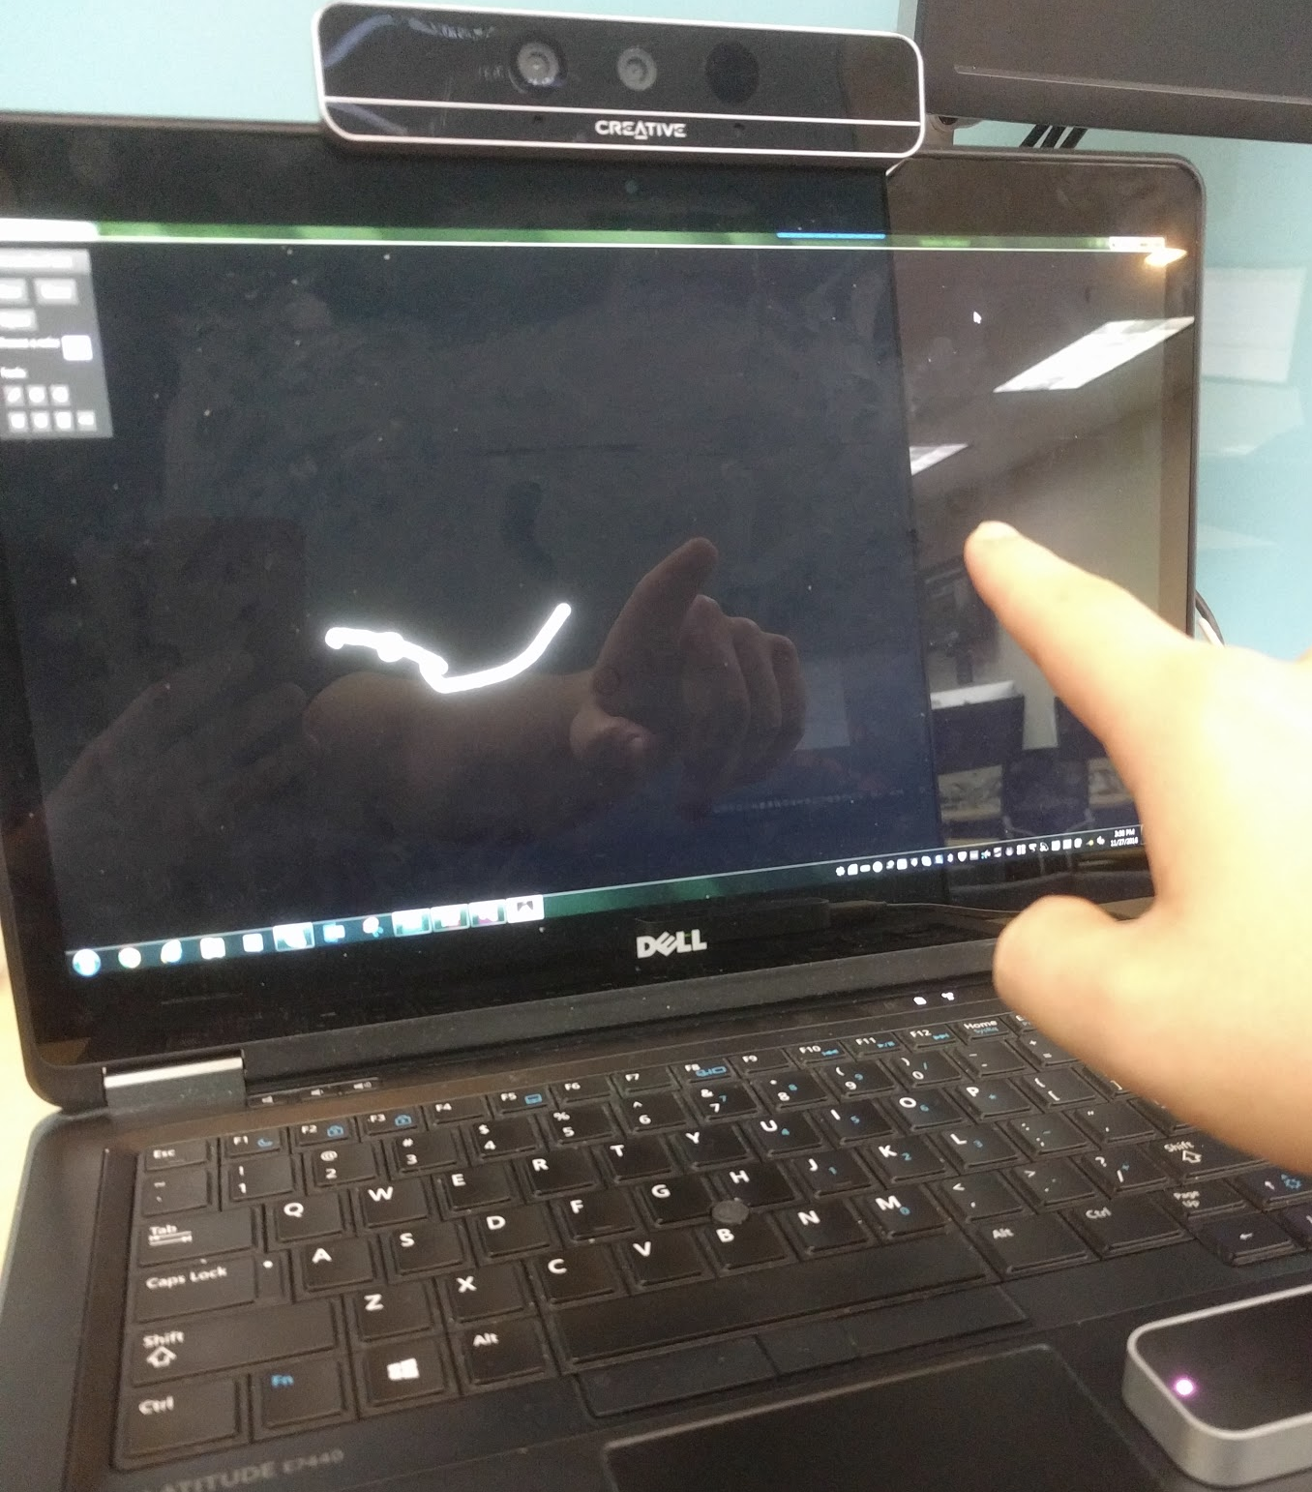
User Story #201
As a user I would want the application to work with multiple input devices such as the Kinect and the Leap Motion.
Acceptance Criteria:
Multiple input devices should be working with the application.
Implementation should be done in such a way that it can be easily switched over to Vulkan once that is ready.
This is when implementation of the handling interactions with input devices began.
Notes:
60 seconds
The tile of user story
The most important user story you worked on it. You have to describe this one very well and be proud of that.
Please present and show the complexity of your work, code, algorithms, and technical challenges and technologies you have used. (you could use screenshot if you want. Visual presentations are better than text presentation)
Go into the details of the most important/significant tasks using bullet lists or visual graphs or state chart diagram
Sequence Diagram for this user story is mandatory (in another separate page if required)
Demo using screenshots or GIF (in another separate page if required)

Slide 9
User Story #230 - HMD Game Framework
As a User, I would like to play an educational game using the HMD, so that its functions can be put to practical use
Acceptance Criteria:
Game uses HMD and controller functions
Game has a defined win state
Game can be implemented and showcased at final presentation
Assets:
Interactable Object that is used throughout the game
Elements that force the user to use the controller set functions (Teleportation, Pick-Up object, and Use object)
Win condition for completing the game
Rule Set:
User must pick up a key-object and take to the end of a maze
Throughout the maze, gates are associated with the 3 main controller functions
Notes:
20 seconds
The tile of user story
Please present and show the complexity of your work, code, algorithms, and technical challenges and technologies you have used. (you could use screenshot if you want. Visual presentations are better than text presentation) - Go into the details of the most important/significant tasks using bullet lists or visual graphs or state chart diagram - Demo using screenshots or GIF (in another separate page if required)
Sequence Diagram for this user story is optional

Slide 10
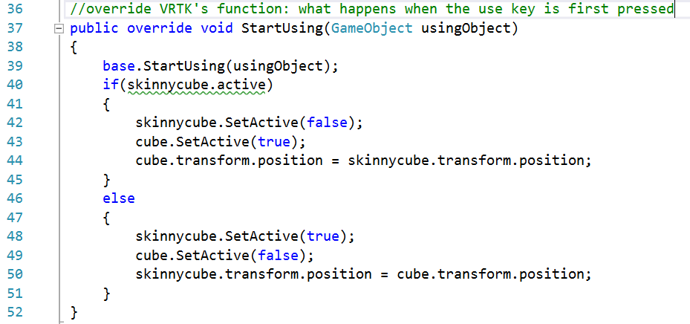
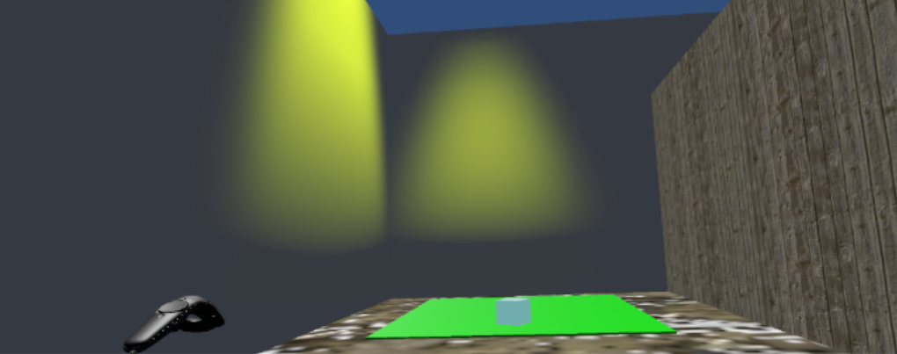
User Story # 230 - HMD Game Framework (Screenshots)
The key item, alongside 2 of the gates - blue gates for the key and purple gates for the teleport beam
Sample Code - the key item’s “Use Button” function: change shape between a cube and a flat box
A simple win-condition: when the key reaches the end of the maze, a golden light animates.

Slide 11
User Story #202 - Add tools to new Cinder integrated project
User Story #202 - Add tools to new Cinder integrated project
As a user, I want to be able to use some basic tools (New, Save, Line, Rotate, and color select).
Acceptance Criteria:
All tools work
All tools can be composed together
Any other criteria specified in the sub-tasks are met
Tasks:
Testing
Documentation
Color selection tool:
As a user, I would like to be able to select different colors so I can draw colorful pictures.
Rotation tool:
As a user, I would like to be able to press a button to rotate the canvas.
Line drawing tool:
As a user, I want to draw a line on a canvas
Saving and loading files:
As a user, I would like to be able to open a picture file (.png, .jpg, etc) in the interactive paint program. (Will use a nanogui control to load the file and display it using cinder)
Notes:
20 seconds
The tile of user story
Please present and show the complexity of your work, code, algorithms, and technical challenges and technologies you have used. (you could use screenshot if you want. Visual presentations are better than text presentation) - Go into the details of the most important/significant tasks using bullet lists or visual graphs or state chart diagram - Demo using screenshots or GIF (in another separate page if required)
Sequence Diagram for this user story is optional

Slide 12
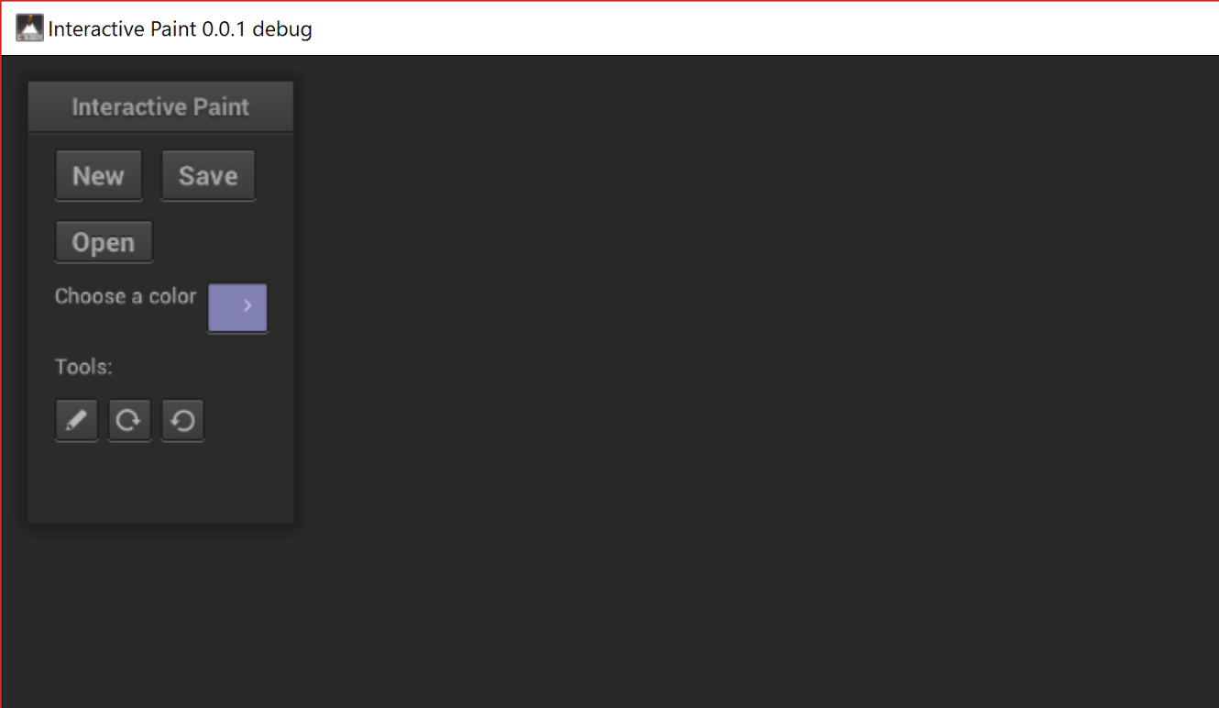
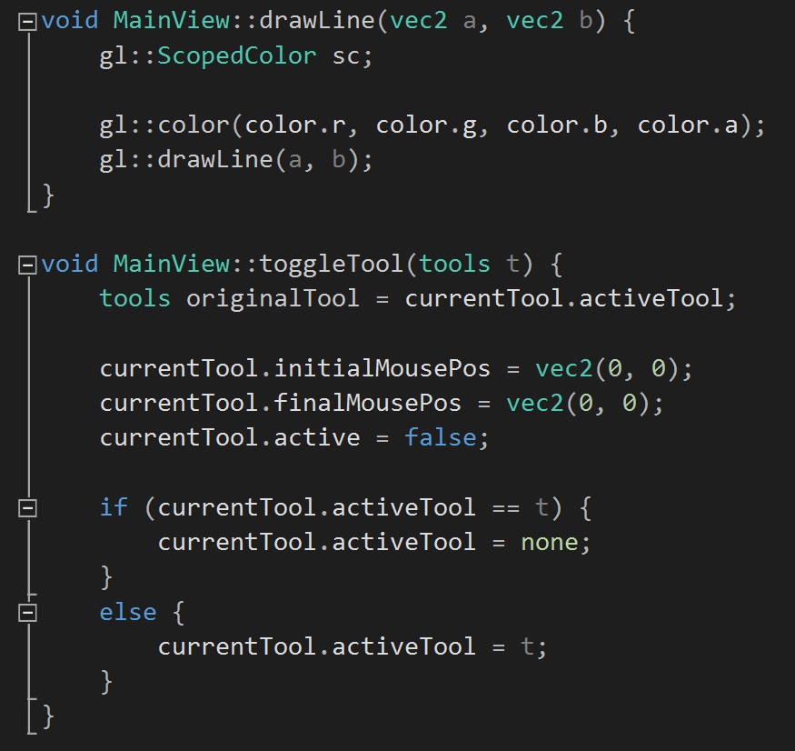
User Story #202 - Add tools to new Cinder integrated project (Screenshots)
Application after sprint:
Code sample:

Slide 13
Test Suites and Test Cases
Integration Tests
This iteration of Interactive Paint was built as 3 disjoint projects and there was little integration.
The painting application built by Jose and Justin was tested by multiple users, each testing different features of the application.
Unit Tests
For the application built by Justin and Jose the methods that poll the input devices for data were tested, the methods that take that data and adjust it to make drawing easier were tested and the methods that draw to the screen were tested.
Notes:
10 seconds
A description of verification process and Test Suites and Test Cases for one of the use cases.
1 One sunny day and one rainy day for the implemented use cases (one or more slides).
2 Automated test scripts for the implemented use cases (if any) (one or more slides).

Slide 14
Unit Test Case examples for VR
Sunny Day Case:
Test case: Win Condition
Purpose: Test to see if win animation plays when key triggers the collider
Preconditions: Win condition has no other objects touching it
Action: User places the key item on the win condition box
Expected result: Yellow light should activate in an animation that increases its intensity
Actual Result: same as expected
Rainy Day Case:
Test case: Key gates
Purpose: Assure that gates can only fit the associated key item; user gates can only let user pass
Preconditions: User has the key item in hand
Action: user presses the teleport button, points to a location, then releases it if the color is green; User attempts to fit the key item into the hole
Expected result: User should teleport to the location. If passing through a transparent purple slot, the key item should be dropped; Key item should fit only into the associated shaped hole
Actual result: same as expected

Slide 15





A Vulkan Component based Rendering Library
Author: Alain Galvan
agalvan@fiu.edu
Mentor: Francisco Ortega
fortega@fiu.edu
Instructor: Masoud Sadjadi
sadjadi@cs.fiu.edu
TA: Mohsen Taheri
mtahe006@fiu.edu

Slide 16

Obsidian is a C++ Vulkan powered component based rendering library inspired by React Native.

Slide 17
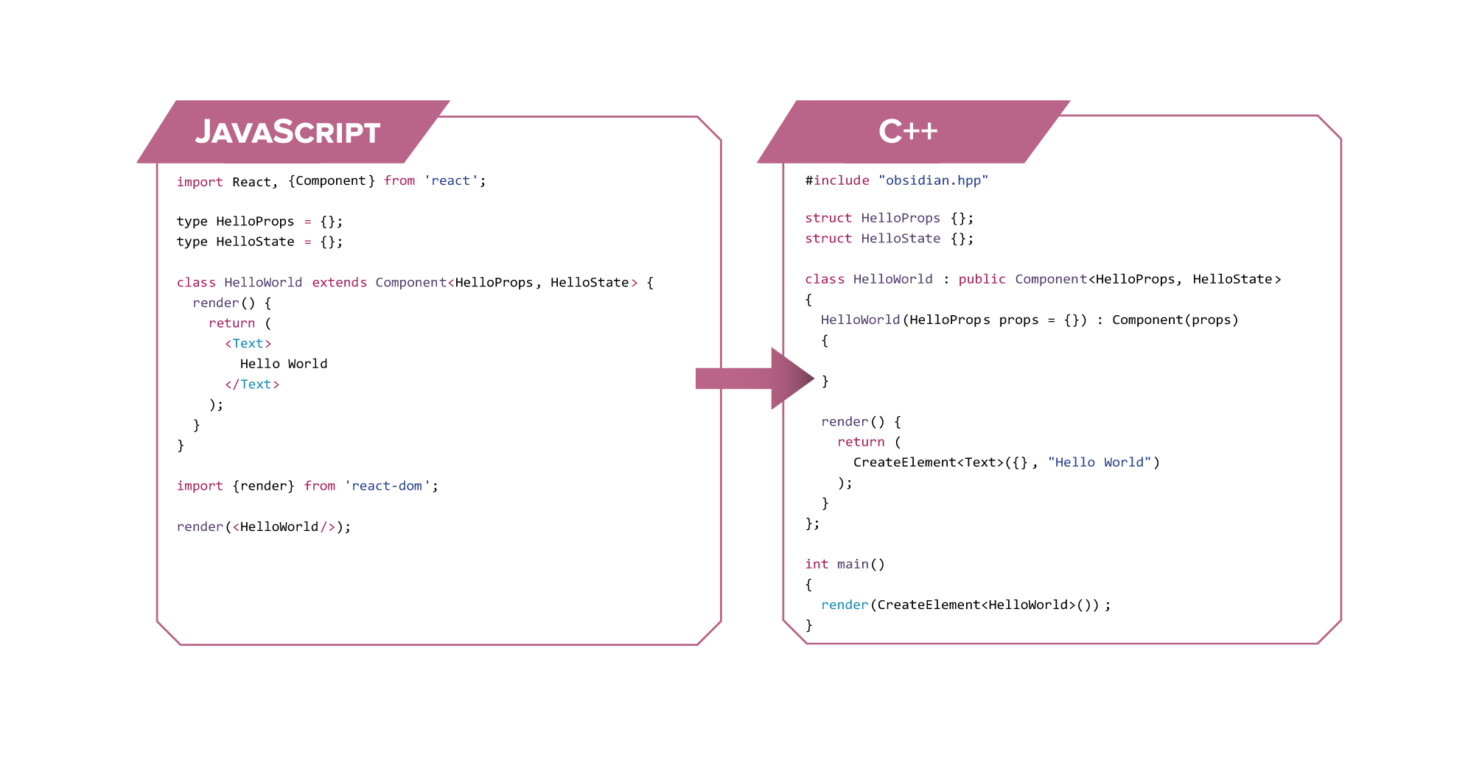

Slide 18
Prior Art
Component based Architectures - Instead of using a Domain Specific Language you compose your application as functions which return factories that build a descriptor graph.
React
React Native
Inferno
Ocaml / F# Trees
The application renderer is then responsible for rendering the tree description, and managing propagating updates through nodes.

Slide 19
Architecture
Package Management - Conan.io manages all our dependencies.
Template programming - For compile-time type safety , zero runtime, and variadic types.
Factory Functions - avoid new, allows custom allocation schemes.
Actor Model - Components are independent actors in an application.
^{|- docs/} ^{|- src/} ^{|- core/} ^{|- component.hpp}
^{|- factory.hpp} ^{|- utils.hpp}
^{|- components/} ^{|- win32.hpp}
^{|- material.hpp} ^{|- mesh.hpp} ^{|- view.hpp} ^{|- config.hpp} ^{|- provider.hpp}
^{|- obsidian.hpp} ^{|- tests/} ^{|- conanfile.txt} ^{|- readme.md}

Slide 20
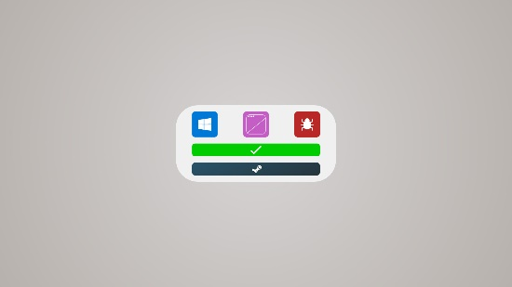
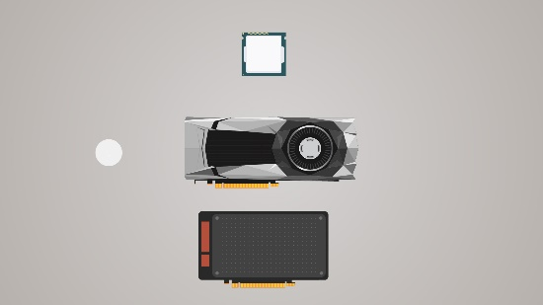
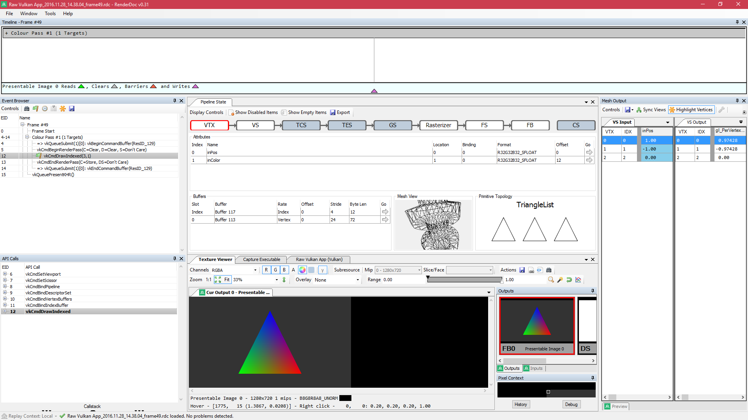
Results
Obsidian is semantically equivalent to React, however for closer integration a “cppx” compiler would be necessary, or integration with XAML similar to WinRT.cpp.
Vulkan constructs are composed to build simple view components similar to HTML.
Vulkan constructs can also be used to make game engine objects like environments and models.
RenderDoc debugging proved essential to profiling performance and tracking errors.

Slide 21
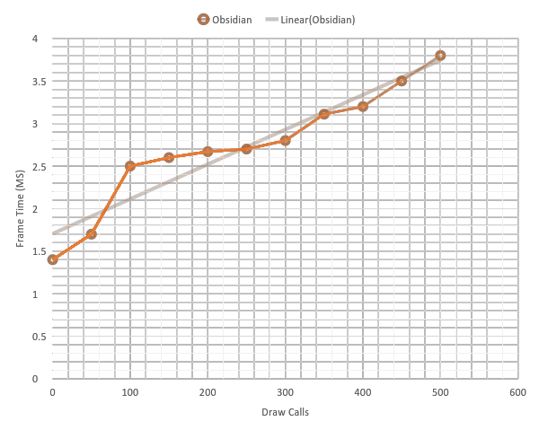
Benchmarks
Machine Specs: Alienware M14X R2 | Nvidia 650M | i7 3610QM @ 2.6 Ghz | 16 GB Ram

Slide 22
Future Work
Shims for other low level graphics APIs such as OpenGL or DirectX 12.
A C++ constexpr shader compiler distributed as a part of the library.
Cross platform compilation to Android and Linux targets, with other platforms supported with shims.
___________________________________________________________
SHIRAEF, J. 2016. An Exploratory Study of High Performance Graphics Application Programming Interfaces. University of Tennessee.
FISHER, B. 2015. Flux: A Unidirectional Data Flow Architecture for React Apps. Applicative 2015.

Slide 23
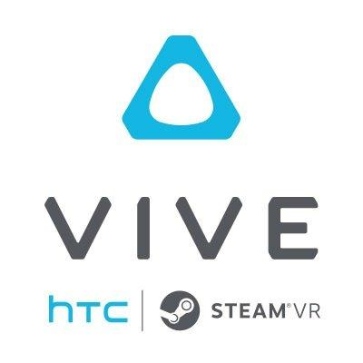







Summary
contact information:
Jacob Leschen Jlesc005@fiu.edu
Jose Morgan jmorg035@fiu.edu
Justin Alvarez jalva304@fiu.edu
Alain Galvan agalv023@fiu.edu
Questions?
Thank You!
Notes:
10 seconds
Summarize your contribution, mention your effort for Scrum, Mingle, Github, Google Drive Documentation and minutes
Include your contact information
Ask if anyone has any questions for you.
Thank your audience

